Slide 1

LYRICS EXTRACTION, TRANSLATION, AND ANALYSIS FROM MUSIC
Team Name: Melody Minors — Music Data Mining Project
Team Members: Jerin Easo Thomas, Krisha Mehta, Radhika Agarwal

Slide 2
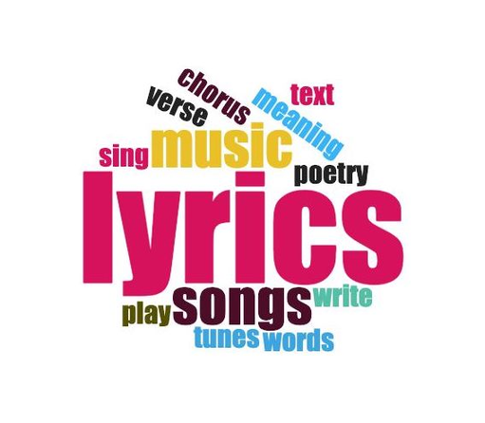
Introduction
In this project, we aim to develop a comprehensive system for lyrics extraction, translation, and analysis from music.
Project Objectives:
Phase 1: PrebuiltPretrained Model Exploration
Phase 2: Building a Custom Model
Phase 3: Lyrics Translation, Summarization, and Music Analysis
Significance of the project:
This project holds significance in various domains, including music analysis, cultural studies, and natural language processing. It can be used to enhance the music listening experience, aid in language learning, and provide insights into the emotional and cultural aspects of songs and music.

Slide 3
Datasets
FMA: A Dataset For Music Analysis:
The FMA (Free Music Archive) dataset is a large collection of music tracks and information.
It includes over 100,000 songs from various genres.
This dataset is great for exploring music trends, creating recommendation systems, or understanding open music licensing.
2. THE DALI Dataset:
This dataset offers a vast collection of music tracks which allows for in-depth analysis of music, lyrics, and vocal patterns.
3. WASABI Song Corpus:
The WASABI Song Corpus is a valuable collection of songs that includes a diverse range of songs and is perfect for music analysis, lyric research, and much more.
4. GTZAN Dataset:
The GTZAN Dataset is a music genre classification dataset widely used in machine learning research.
It contains 1000 audio tracks, each 30 seconds long, representing 10 genres: Blues, Classical, Country, Disco, Hip-hop, Jazz, Metal, Pop, Reggae, and Rock.
The dataset also includes two CSV files containing extracted features from the audio files- One file contains the mean and variance of multiple features for each song. In contrast, the other file contains a more comprehensive set of features, including spectral features, rhythm features, and timbre features.

Slide 4
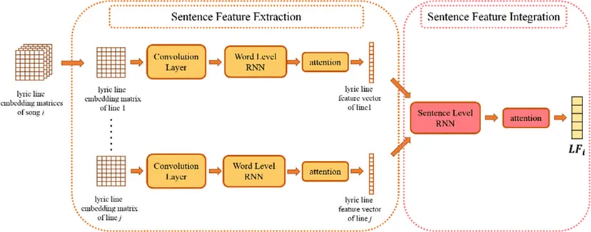
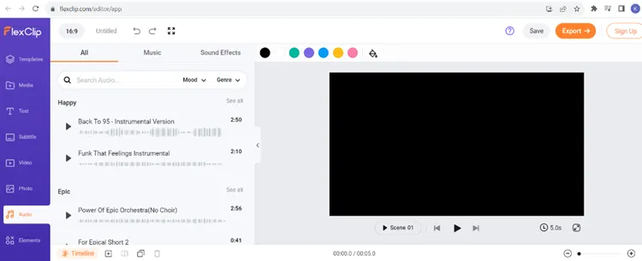
Examples
The diagram in the image shows:
Sentence feature extraction and sentence feature integration
Lyrics of a song can be used to extract features that can be used to transcribe the song.
2. FlexClip
FlexClip is an AI tool to transcribe song lyrics from music audio that can quickly recognize and convert other audio and video content into text.
It supports over 140 languages and various accents in your videos, ensuring high transcription accuracy.
We can extract lyrics from songs in multiple languages, including English, German, Spanish, French, and more.

Slide 5
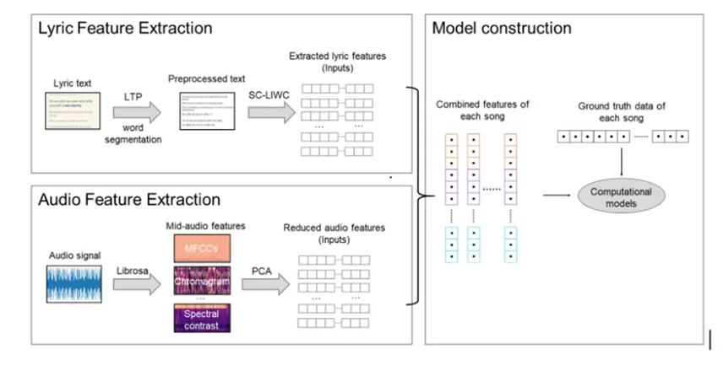
Examples
3. The diagram shows the two main components of music lyrics extraction:
Lyric feature extraction involves extracting features from the lyrics of a song.
These features can include:
like the number of words in the song
the frequency of certain words
the presence of certain grammatical structures.
Audio feature extraction involves extracting features from the audio recording of a song.
These features can include:
pitch of the singer’s voice,
the tempo of the song
presence of certain musical instruments.
Once the lyric features and audio features have been extracted, they can be used to train a machine-learning model to predict the lyrics of a song.

Slide 6
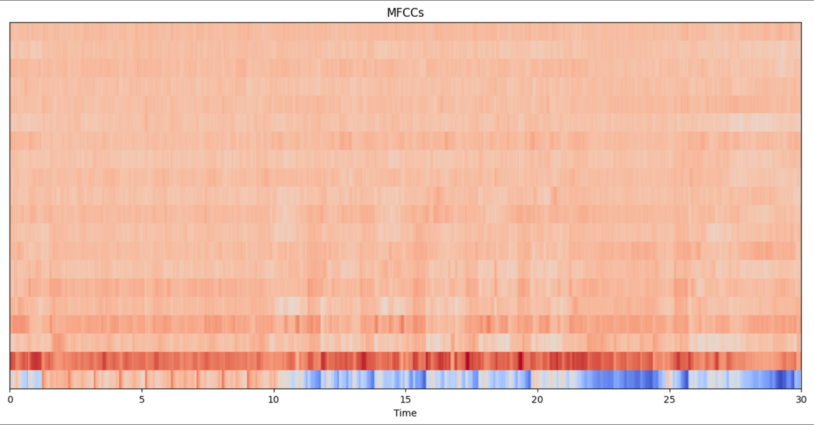
System Description
Phase 1: Audio to Lyrics Generation using Prebuilt Models
For this phase we have used 2 pre-built existing models for lyrics extraction:
Wave2Vec2
Whisper
Results: After evaluating the system, it was found that, for the given dataset, the Whisper model performed better results in comparison to Wave2Vec2 model.

Slide 7
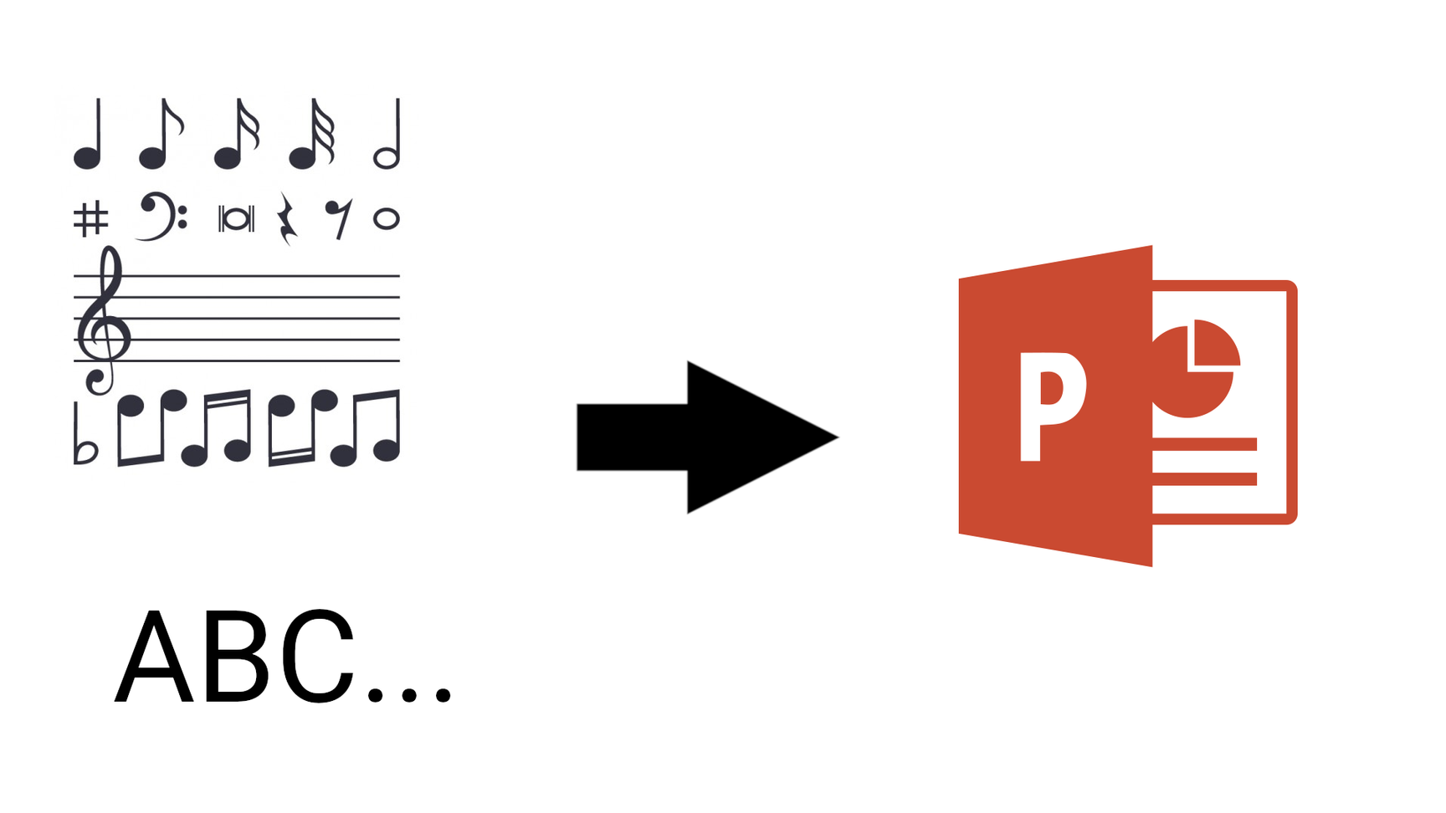
Phase 2: Fine-tuning and Result Comparison
The objective in this phase is to enhance the system’s accuracy by fine-tuning Wav2Vec2 on a labeled dataset of audio and text.
Employed Flash library:
Lightweight framework for building deep learning models
Offers features such as distributed training, GPU acceleration
Outcome: When the accuracy of the fine-tuned Wav2Vec2 model was compared to the accuracy of the pre-trained Whisper model, the pre-trained Whisper model exceeded the fine-tuned Wav2Vec2 model.

Slide 8

Phase 3: Music Analysis
The system focuses on a full study of music at this phase by conducting:
genre classification
summarization
emotional tone detection
lyrics translation to user-specified languages

Slide 9
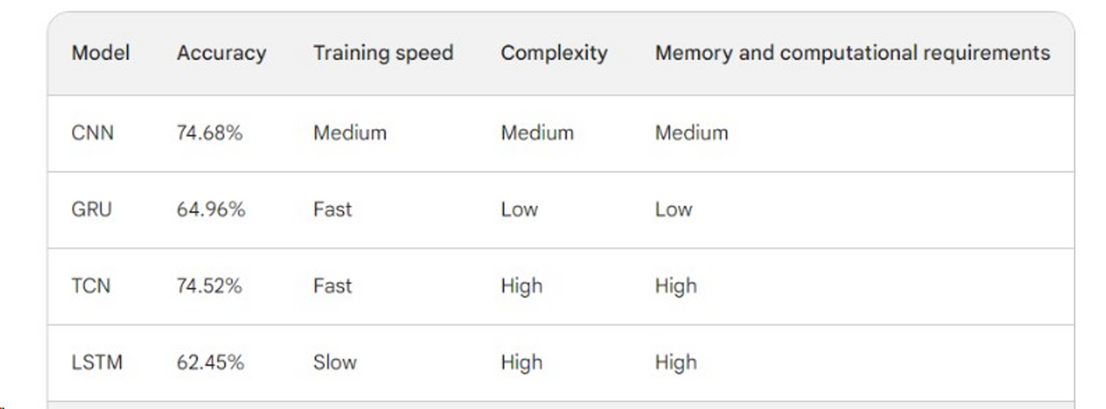
Genre Classification Model
Four models were built:
Convolutional neural network (CNN)
Gated Recurrent Unit (GRU)
Temporal Convolutional Networks (TCN)
Long Short-Term Memory (LSTM)
An ensemble model was also created by combining the predictions of these models.This ensemble model achieved an accuracy of 82.51%

Slide 10
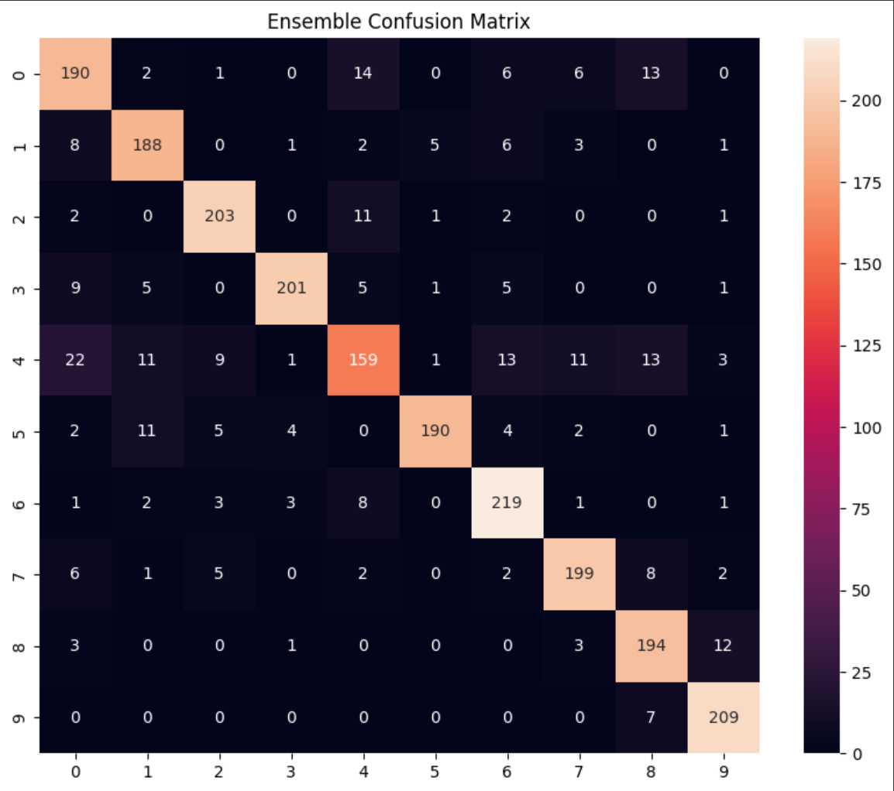
Ensemble Confusion Matrix

Slide 11
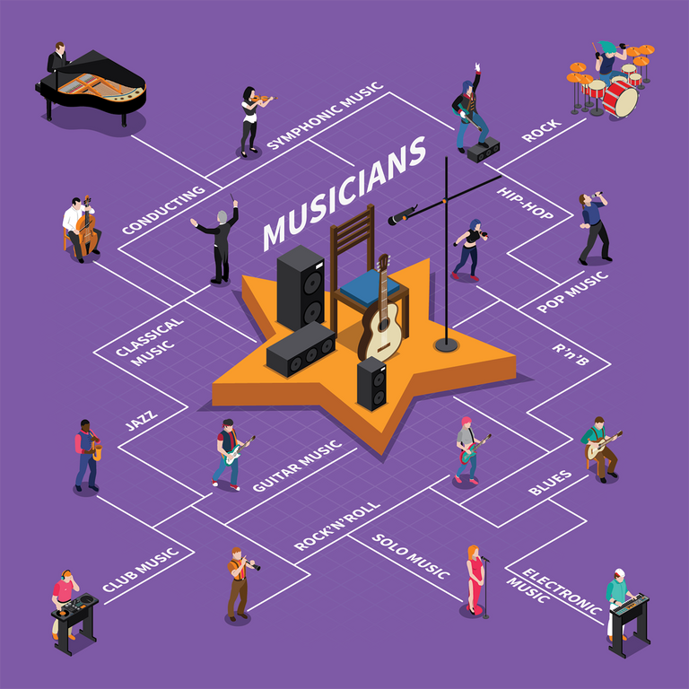
Music Analysis:
After fine-tuning our model and recognizing that our scratch-built model excelled primarily in genre classification, we opted to leverage pre built models for a more comprehensive music analysis.
This music analysis comprises several key components:
Lyrics Extraction: Used the Whisper model
Lyrics Summarization: g4f Chat Completion model (involves generating concise summaries of song lyrics using AI-powered text completion techniques).

Slide 12
Genre Classification: Musical-genres-Classification-Hubert-V1 model (designed for AI-based genre classification of music, enabling it to automatically categorize songs into different musical genres).
Emotion Detection: xlsr-wav2vec-speech-emotion-recognition model (specialized in recognizing and categorizing emotions from speech audio, providing automated emotion detection capabilities).
Lyrics Translation: Google Translate API (allows developers to integrate automatic translation of lyrics and text from one language to another using Google's machine translation technology).

Slide 13

Results:
Here’s an illustrative example of the results generated by our system:
Lyrics: “Make it a double. Below the ocean, I make my bed down there. Below the ocean, I gotta live somewhere. Maybe the graveyard, yeah maybe I don’t care.”
Summary: The song’s theme revolves around an individual feeling lost or overwhelmed, contemplating seeking solace or escape in the depths of the ocean. The lyrics hint at the possibility of establishing a residence underwater, perhaps in a graveyard, symbolizing isolation or indifference towards their present circumstances.
Genre Prediction: The system predicts the genre of the music, with a score of 0.801801860332489, classifying it as ‘rock.’

Slide 14
Emotion Prediction: Emotions expressed in the music are detected, with scores and labels provided. In this case, the detected emotions are ‘happiness’ (0.5177) and ‘sadness’ (0.3168).
Translation: The lyrics are translated into a different language for broader accessibility. In this example, the translation is provided in French: “Faites-en undouble. Sous l’océan, je fais mon lit là-bas. Sous l’océan, je dois vivre quelque part. Peut-être le cimetière, ouais, peut-être que je m’en fiche.”

Slide 15
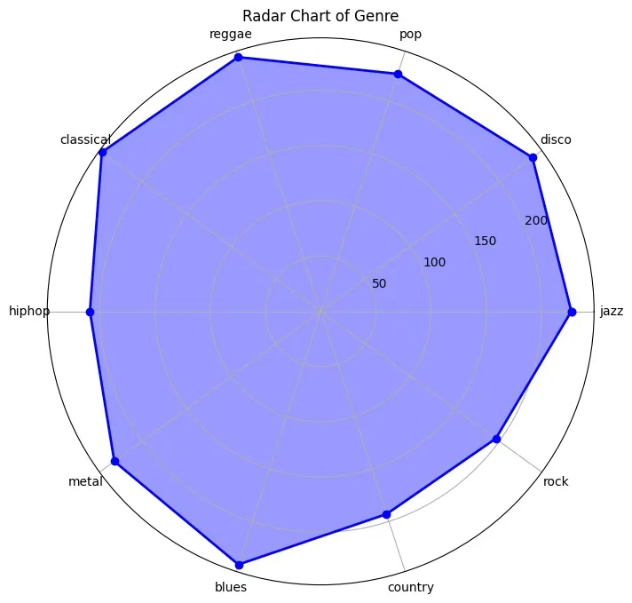
The radar chart shows that classical, reggae, and blues are the most popular genres of music, while rock, hip hop, and country are the least popular genres of music in our dataset.

Slide 16
References:
https://www.flexclip.com/learn/extract-lyrics-from-song.html
https://peerj.com/articles/cs-785/
https://www.researchgate.net/figure/The-lyrics-feature-extraction-CRAHARNN-architecture_fig4_349053857
https://huggingface.co/SeyedAli/Musical-genres-Classification-Hubert-V1
https://huggingface.co/harshit345/xlsr-wav2vec-speech-emotion-recognition
https://archives.ismir.net/ismir2022/paper/000001.pdf
https://arxiv.org/pdf/2108.02625.pdf
https://arxiv.org/pdf/2007.06486.pdf
https://aclanthology.org/2020.nlp4musa-1.7.pdf
https://arxiv.org/ftp/arxiv/papers/1812/1812.08318.pdf

Slide 17
Thank you!

